Slide 1
Feedback Analysis
1. Scope & Objectives
2. Key Findings
3. Topic Modeling
4. Sentiment Analysis

Slide 2
Scope & Objectives
Problem Definition
Understand customer feedback on products and services offered by the bank in order to understand pain points and optimize existing offerings.
Data collected from various sources such as website, mobile app and social media.
Solution
Leverage AI power to analyze free text data and cluster similar feedbacks together.
Create mechanism able to predict customer sentiment.

Slide 3
Feedback Analysis
1. Scope & Objectives
2. Key Findings
3. Topic Modeling
4. Sentiment Analysis

Slide 4
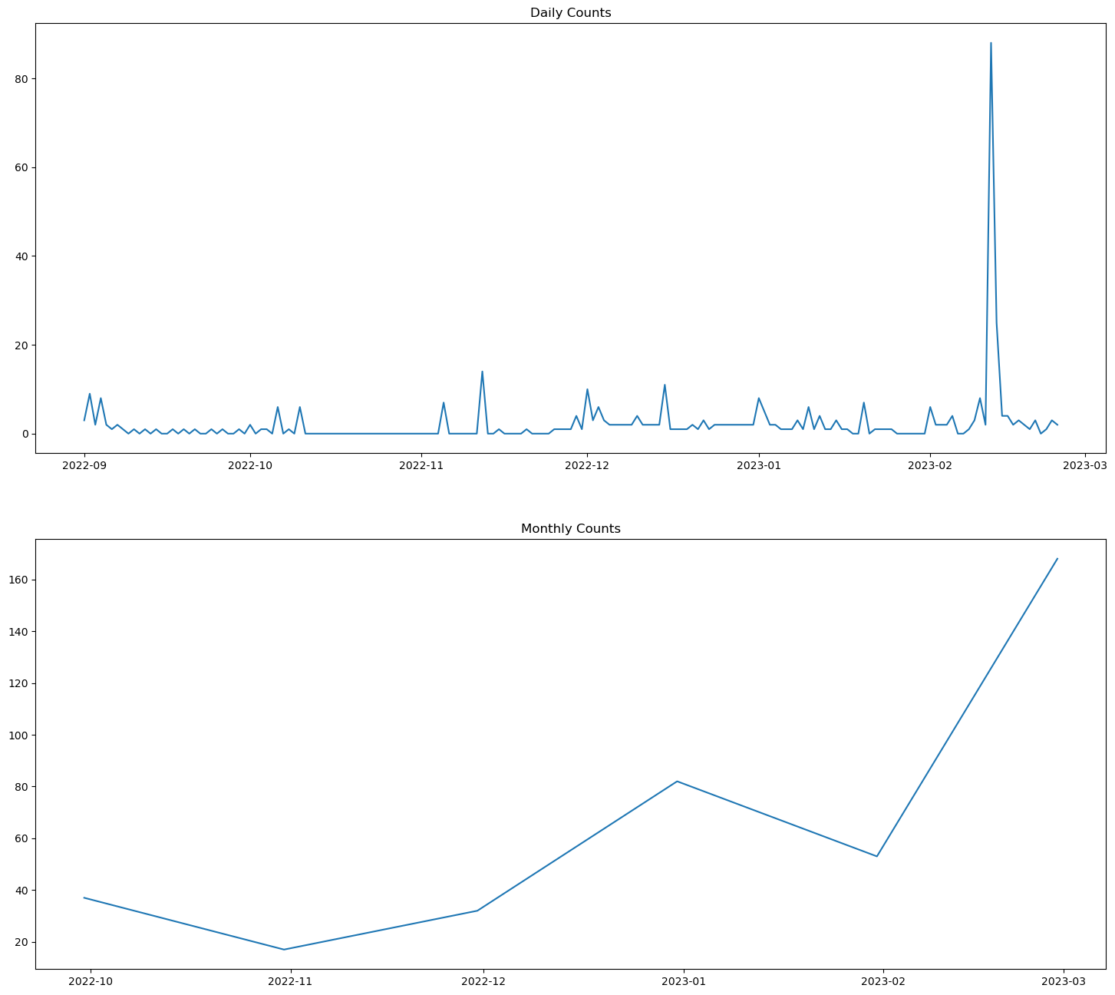
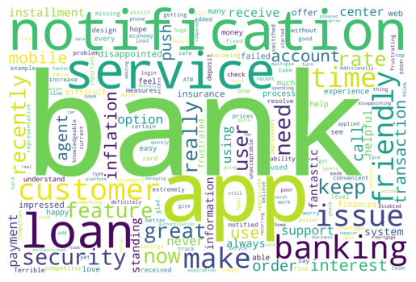
Key Findings - Overview
A glimpse on the dataset shows a major increase on monthly feedbacks after December 2022.
Unfortunately, visualizing the most frequent words on feedbacks provides us with incoherent and generic results.

Slide 5
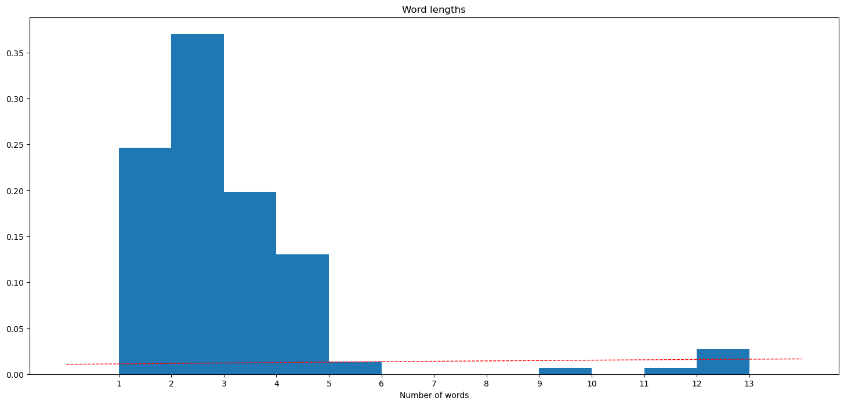
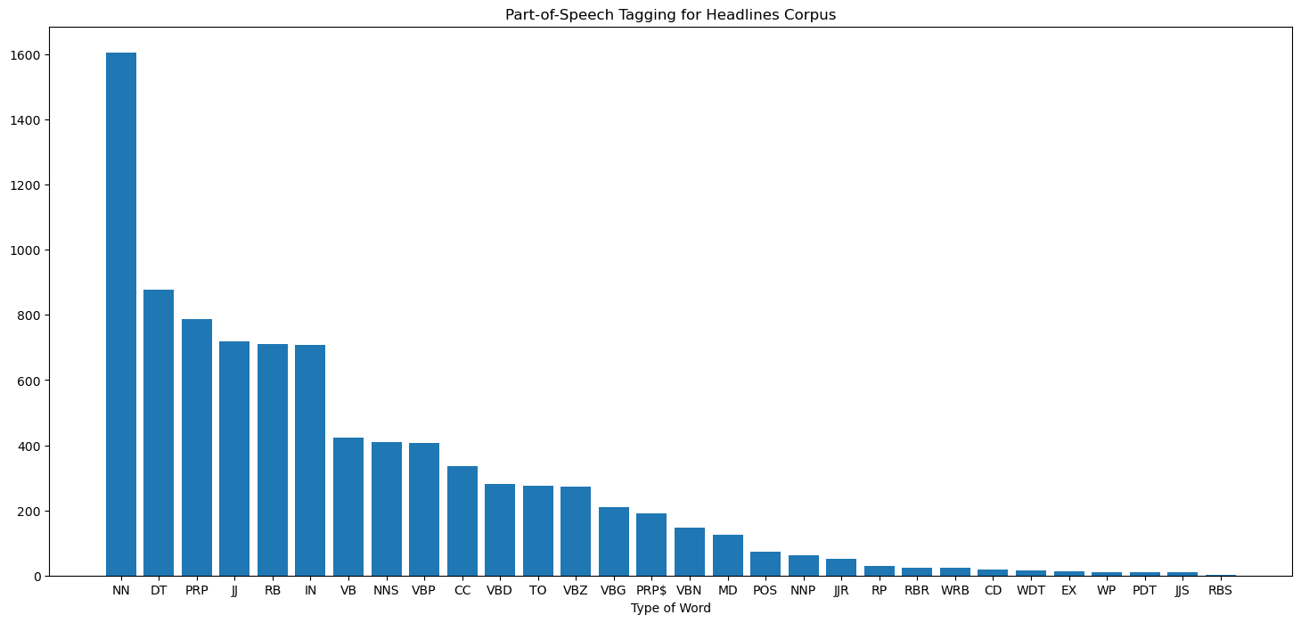
Key Findings - POS
Removal of irrelevant words such as stop words.
Majority of feedbacks tend to have quite a small length as also seen from the graph and more specifically one, two or three words.
When it comes to part of speech in the text data, nouns are by far the most abundant objects along with determiners and personal pronouns.

Slide 6
Feedback Analysis
1. Scope & Objectives
2. Key Findings
3. Topic Modeling
4. Sentiment Analysis

Slide 7
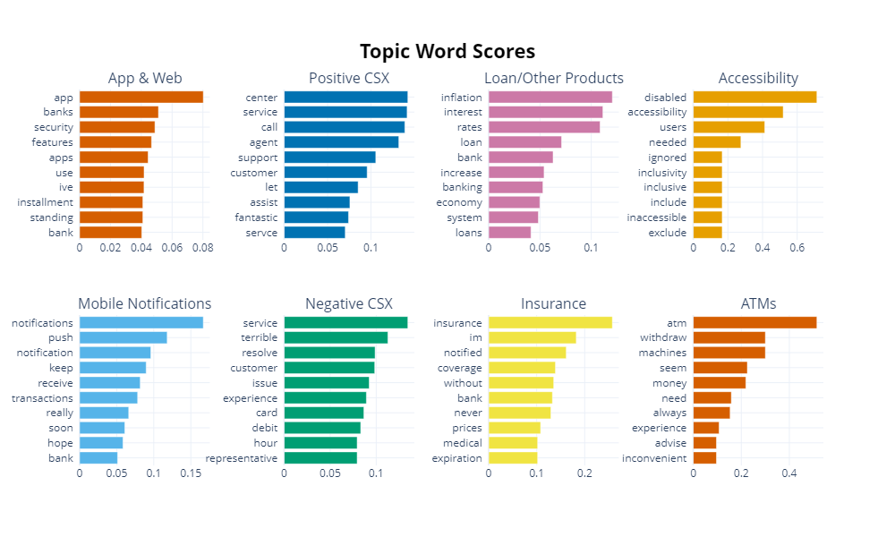
Topic Modeling
Twenty one topics identified initially.
Merging similar topics in one resulted in 8 distinct and clear groups of feedbacks and their associated, most important words mentioned.
Derived topics can have a positive or a more negative tone.

Slide 8
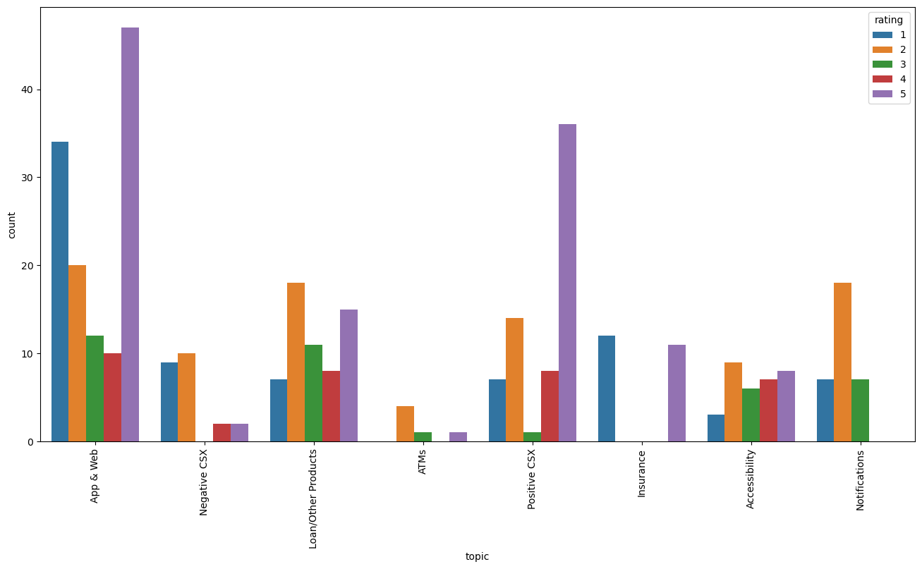
Topic Modeling
Ratings provided, in many occasions confirm the topics created. Especially for “Negative CSX” or “Positive CSX” we see that majority of feedbacks have an either very low or very high rating respectively.
Comments about insurance provided by the bank are either very low or very high.
Mixed feelings when it comes to the rest of topics.

Slide 9
Feedback Analysis
1. Scope & Objectives
2. Key Findings
3. Topic Modeling
4. Sentiment Analysis

Slide 10
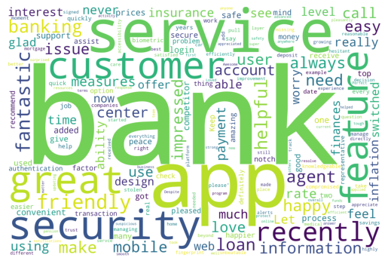
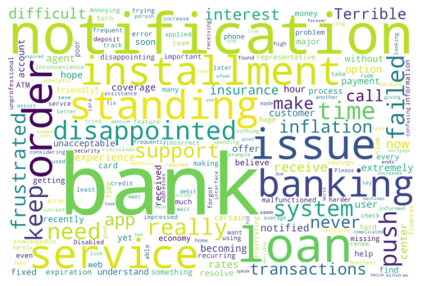
Sentiment Analysis
Positive Sentiment
Negative Sentiment
Maximum rated feedbacks accumulate for roughly 31% of total but low rated exceed that by far.
Ratings have been grouped in two distinct categories each one representing a sentiment:
In positive sentiments we come across frequent references to the bank app, customer service and adjectives such as fantastic, friendly, easy and great.
In contrast negatively characterized feedbacks refer massively to annoying notifications, installments of loans and transactions.
Positive
Negative

Slide 11
Results
Overall classification accuracy of sentiments reaches 86%.
Predicting negative sentiments seems to be the most important segment where the bank needs to focus in order to improve its services and customer experience overall.
With respect to the former, accurate predictions of negative sentiments hits 88%.
Recommendations
Less and relevant notifications to bank customers.
Improvement on insurance coverage.
Identification of negative customer service pain points.
Communicate to customers the security measures the banks employs in order to keep their account safe – Ease their mind.
 | Precision | Recall | F1-Score | Support
Positive | 0.83 | 0.83 | 0.83 | 30
Negative | 0.88 | 0.88 | 0.88 | 43
Accuracy |  |  | 0.86 | 73
Macro avg | 0.86 | 0.86 | 0.86 | 73
Weighted avg | 0.86 | 0.86 | 0.86 | 73

